Slide 1

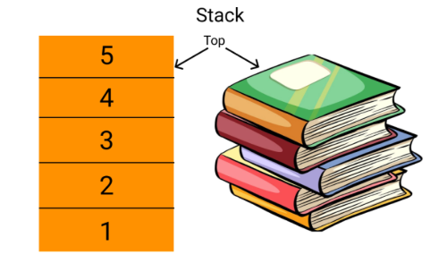

STUDENT ATTENDANCE PATTERN DETECTOR

Slide 2
AIM OF THE PROJECT
Managing the attendance using traditional approach is really a cumbersome process. The person has to maintain the attendance record in registers and file using pen and paper.
The problem with this approach is that it requires lots of paper which are the part of our non-renewable natural resources. We are in the age, where we have to think about sustainable development.
Managing the attendance using web applications, provide an alternative way in this direction. Communication between teachers and the parent is also an important issue.
Our proposed application provide all information about results, attendance and notification for parent and student easily in online.
So, we also tried to bring the system which enables parent to receive the information of their ward of regularity on daily basis.

Slide 3
🖥️ SAMPLE OUTPUT
🎓 STUDENT ATTENDANCE DETECTOR SYSTEM
1. Record Today's Attendance
2. View Attendance History
3. Find Consistently Present Students
4. Find Students with Irregular Attendance
5. Search Attendance by Student ID
6. Undo Last Attendance Entry
7. Save Attendance to File
8. Load Attendance from File
9. Exit

Slide 4
EXISTING SYSTEM
It provides mobility to the users to access the attendance record at any time and at any place.
The Mobile Phone is relatively cheaper than the Computer on the average, so economically it has advantage over that.
In an environment of poor maintenance culture, Mobile phones are less prone to malfunctioning when compared to Computers so; Cheaper Maintenance is the next added advantage for any system based on mobile phones.
The reduction in Paper material being used in traditional method of pen and paper based attendance system, thus preserving the Forests of the world (the small phone can contain hundreds of thousands of pages of books, and written materials).
It is a Green technology.
Availability wise also it is preferable, today mobile phone is available to every other person as compared to computer. So, any institution does not need to incur any extra cost while installing the system.

Slide 5
DISADVANTAGES OF EXISTING SYSTEM
It is time consuming​
It consumes lot of manpower to better results​
It lacks of data security​
Retrieval of data takes lot of time​
Percentage of accuracy is less​
Reports take time to produce

Slide 6
PROPOSED SYSTEM
The advantages of our system are as follow:
Ease up the process of attendance.
Easy Analysis of data.
Better user interface.
Made access to the record of attendance available 24X7.
Reduced dependency on natural resources for paper.
Easy generation of summary of attendance.
Make the process of attendance a green process.
Provide communication between teachers and parents.
Automatic SMS will be sent to parents to inform the status of their ward whether present or absent in the institution.

Slide 7
ADVANTAGES OF PROPOSED SYSTEM
The Project has several features and easy to manage.
1. The System is user friendly.
2. Cost effective.
3. Back up support.
4. Secured Data.

Slide 8
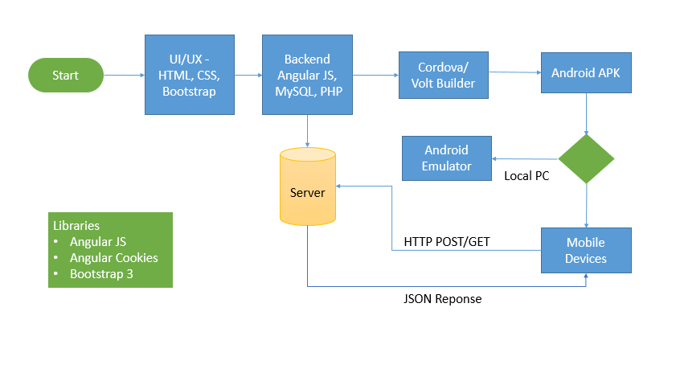
WORK FLOW DIAGRAM FOR ANDROID

Slide 9
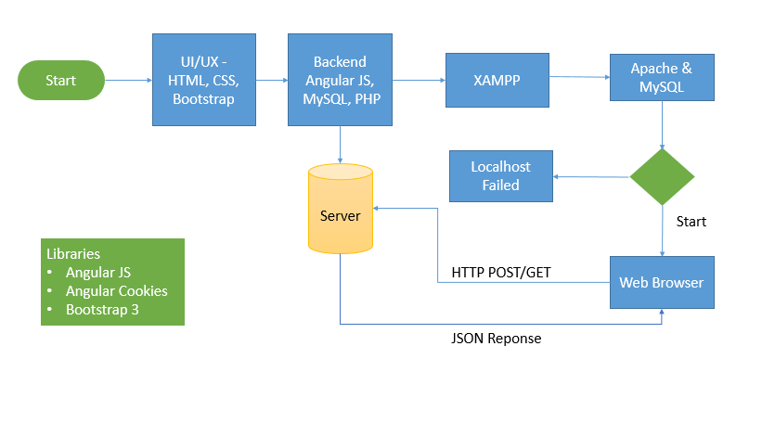
WORK FLOW DIAGRAM FOR WEB APPLICATION

Slide 10
CONCLUSION
In this paper we have discussed about the problems caused due to the use of traditional approach in taking the attendance and solutions for that through the use of mobile and provide a new approach.
The goals achieved in following this approach: Automate the attendance management using mobile devices to reduce the dependencies on natural resources and also provides a way of communication between parents and teachers.
Integrating the student’s mobile phones with the application so that the application detects automatically the students that are present is a great thing to be added in the future.
Integrate it with the centralized server of the college/school so that the server will send the SMS to the guardians of the absentee’s students and informing them about his or her ward.
We will try to generate the daily report that will be submitted to the centralized server for its record.

Slide 11
FUTURE ENHANCEMENT
In Future work, This application to develop a cross platforms like IOS, etc.
In adding the more features student daily attendance management system to develop access with user’s flexibility.
To authenticate the users based on the system users list which is maintained by the operating system
To restrict the usage of all files by the users based on their privileges on the system

Slide 12

SOFTWARE AND HARDWARE REQUIREMENTS
HARDWARE REQUIREMENTS:
Processor : intel 3
Motherboard : intel 915gvsr chipset board
Ram : 4 gb ddr2 ram
Hard disk drive : 160 gb
SOFTWARE REQUIREMENTS:
Front end : html5, css3, bootstrap
Back end : php, mysql
Control end : angular java script
PHP TOOLS:
xampp-win32-5.5.19-0-VC11
ANDROID TOOLS:
Android Emulator
xampp-win32-5.5.19-0-VC11
Android Studio

Slide 13
MODULE LIST
ADMIN
Can create/delete an account.
Can view the student’s accounts.
Can change the password.
Insert/delete/edit the information of available on daily attendance system.
Create/delete accounts (add list of his student)
Change password for Student
Create/ delete/update courses (subject).

